Slide 1


Stroke Analysis
Presenter: Manju Sankaranarayanan

Slide 2
Content Synopsis
OVERVIEW OF KEY IDEAS
Introduction
Goals
Initial Analysis
Hypotheses
Conclusion

Slide 3


What exactly is Stroke?
A Stroke occurs when a blood vessel that carries oxygen and nutrients to the brain is either blocked by a clot or bursts (or ruptures). When that happens, part of the brain cannot get the blood (and oxygen) it needs.
Stroke is a disease that affects the arteries leading to and within the brain. It is the No. 5 cause of death and a leading cause of disability in the United States. Around 15 million people are affected by stroke worldwide.

Slide 4

Introduction
The project is about Stroke Analysis Prediction. Dataset used here is from: https://www.kaggle.com/fedesoriano/stroke-prediction-dataset The data consists of 5110 observations and 12 attributes. This dataset is used to predict whether a patient is likely to get stroke based on the various parameters like age, gender, obesity, glucose levels, heart conditions, marriage and smoking status. Each row in the data provides relevant information about the patient.

Slide 5
Analyze the relationship between gender, age, various diseases, and smoking status.
Goals
How do these factors affect people? Are they the correct predictors of a stroke in a person?

Slide 6
Approaching the data
Imported CSV file and libraries into Jupyter Notebook
Data Exploration, Cleaning, and Descriptive Statistics
Checked for Correlation with Pearsonr.
Split data into sample populations through conditional filtering.
Performed statistical analysis using t-test for the numerical variables.
Performed statistical analysis using chi-squared test for categorical variables.
Found 95% confidence intervals.

Slide 7
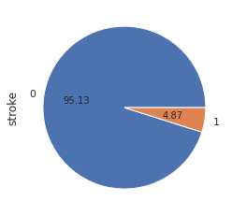
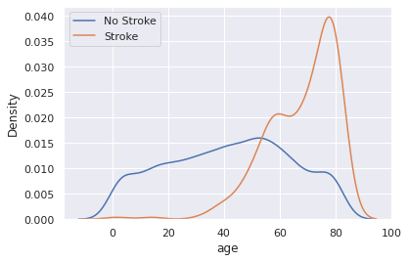
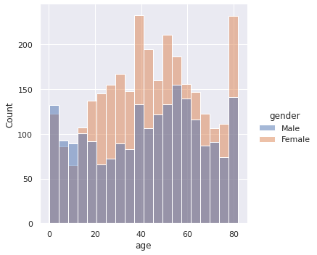
We are clearly dealing with an imbalanced dataset where only 4.87% of the sample population have strokes and 95.13% have no stroke..
Patients above 40 years of age are more prone to a stroke.
Chances of getting a stroke is slim to none for patients 25 years and less.
There are clearly more females than males in the dataset.
Initial Analysis

Slide 8
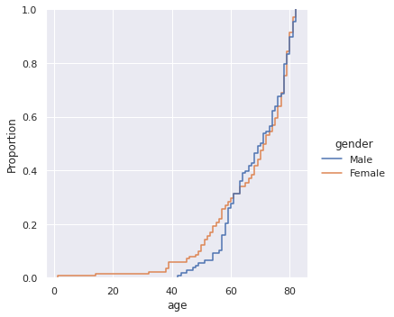
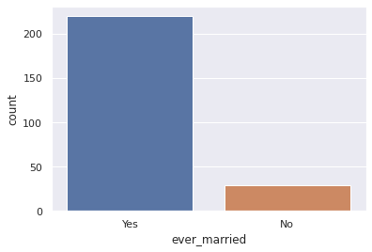
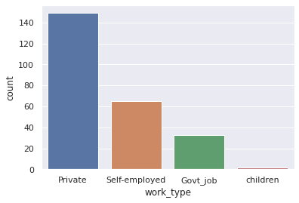
Both male and female have an equal chance of getting a stroke but males between 60 and 80 years of age have a slightly higher chance of having a stroke when compared to females.
People who are married are prone to a stroke than people who are not.
People working in Private sector and self employed have higher chances of stroke.
Initial Analysis

Slide 9
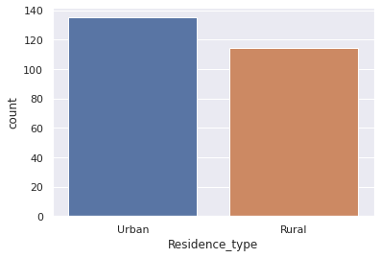
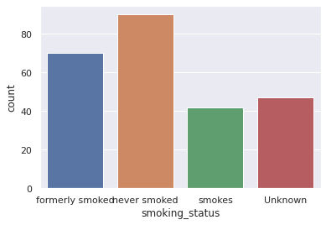
People living in Urban areas are more prone to a stroke than people in rural areas.
People who have formerly smoked and are smoking have a high chance of getting a stroke. But according to this particular dataset, people who have never smoked have the highest chance of a stroke which is questionable. It might be due to fact that the dataset is highly imbalanced.

Slide 10
Checking if the mean BMI for those age greater than 45 is equal/ not equal to the mean BMI for those less than 45.
Hypotheses
T-test
Checking if the mean BMI for individuals with glucose levels greater than 90 is equal/ not equal to the mean BMI for those less than 90?

Slide 11
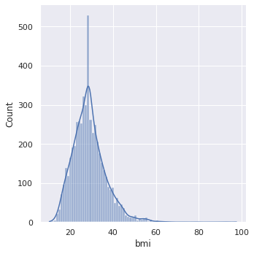
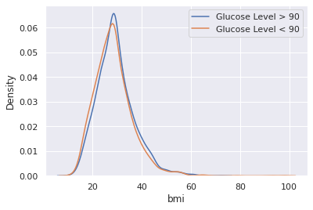
Glucose Level and BMI
Evaluating statistical significance between Avg. Glucose Level and BMI.
The null and alternative hypotheses are as follows:
H₀: µ₁ = µ₂ ( The mean BMI for individuals with glucose levels greater than 90 is equal to the mean BMI for those less than 90.)
Hₐ: µ₁ ≠ µ₂ (The mean BMI for individuals with glucose levels greater than 90 is not equal to the mean BMI for those less than 90.)
Statistic Value: 3.96
p-Value: 7.68416578422278e-05

Slide 12
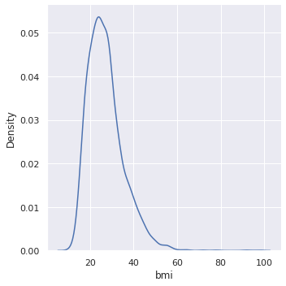
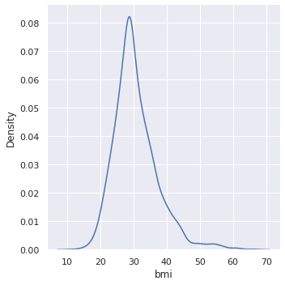
Age and BMI
Evaluating statistical significance between Age and BMI.
The null and alternative hypotheses are as follows:
H₀: µ₁ = µ₂
( The mean BMI for those age greater than 45 is equal to the mean BMI for those less than 45.)
Hₐ: µ₁ ≠ µ₂
(The mean BMI for those age greater than 45 is not equal to the mean BMI for those less than 45.)
Statistic Value: 17.21
p-Value: 1.4276153587628098e-64

Slide 13
Checking if hypertension and stroke are dependent or independent of each other?
Hypotheses
Chi-test
Checking if heartdisease and stroke are dependent or independent of each other?

Slide 14
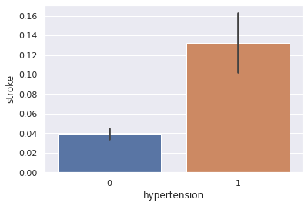
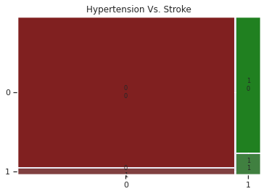
Hypertension and Stroke
Evaluating statistical significance between Hypertension and Stroke.
Null hypothesis, H₀ : Hypertension and Stroke are independent.
Alternative hypothesis, Hₐ : Hypertension and Stroke are dependent
Significance level, α is generally set to 0.05.
• p-value ≤ α : significant result, reject null hypothesis.
• p-value > α : not significant result, fail to reject null hypothesis
Chi-Statistic Value: 81.57
p-Value: 1.688936253410575e-19

Slide 15
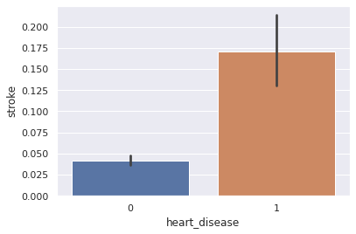
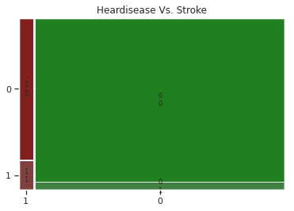
Heartdisease and Stroke
Evaluating statistical significance between Heartdisease and Stroke.
Null hypothesis, H₀ : Heartdisease and Stroke are independent.
Alternative hypothesis, Hₐ : Heartdisease and Stroke are dependent
Significance level, α is generally set to 0.05.
• p-value ≤ α : significant result, reject null hypothesis.
• p-value > α : not significant result, fail to reject null hypothesis
Chi-Statistic Value: 90.23
p-Value: 2.120831133146208e-21

Slide 16
Some of the risk factors for Stroke that we have seen are:
Hypertension
Heart condition
Obesity
Diabetes
Conclusion
The reality is that 80% of strokes are preventable. You can prevent stroke by making healthy life style choices.
Physical activity and exercises can help you stay at a healthy weight and lower your cholesterol and blood pressure levels.
Choose a healthy diet.
No Smoking
Treating diabetes can delay the onset of complications that increase the risk of stroke.
Finally, follow your doctors recommendations carefully.

